Slide 1
GEOMETRY CLIPMAPS
TERRAIN RENDERING USING NESTED REGULAR GRIDS
by MARKEL PISANO BERROJALBIZ

Slide 2
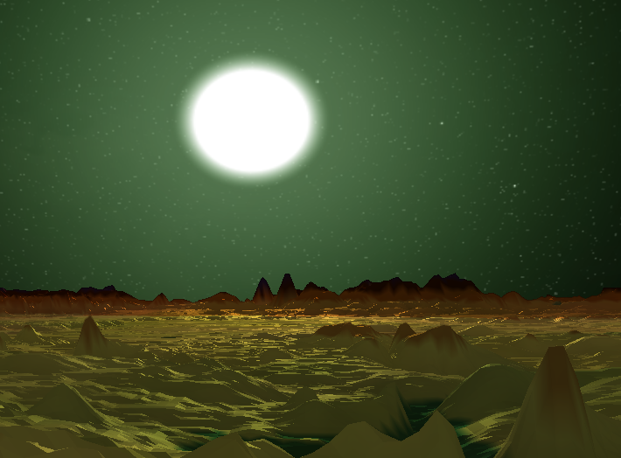
We want to
Be able to store on memory and render HUGE terrain.

Slide 3
How?
Use uniform grids attached to the camera.
Apply LOD based on center of view.

Slide 4
Implementation
Use High Resolution height-map.
Construct uniform grid meses.
Place grids at different LODs.
Frustrum culling.
Sample height-map by world positions.
Modify vertex altitude.

Slide 5
1. Use High Resolution height-map
We want to at least have a resolution of 1 vertex to 1 pixel at the lowest level.
Vertices > pixels = Aliasing
Pixels > vertices = Flickering (terrain seem to have waves).
Let’s say we want to load a map of 4096x4096.
Vertex Positions = 4096 x 4096 x 3 x 4 = 201,326,592 bytes = 192 MB
Height map = 4096 x 4096 = 16,777,216 bytes = 16 MB

Slide 6
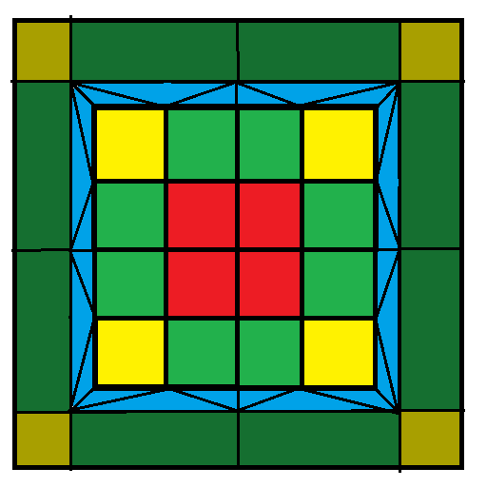
2. Construct uniform grid meses.
4 mesh types:
Core grid.
Side grid.
Corner grid.
Interlevel mesh.
Margin between levels.

Slide 7
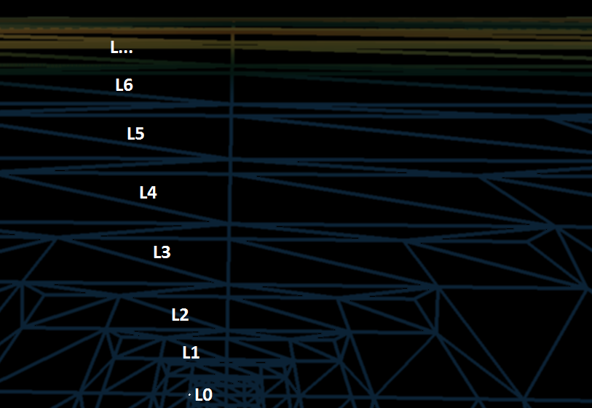

3. Place grids at different LODs
SCALE = $2^{Level}$

Slide 8
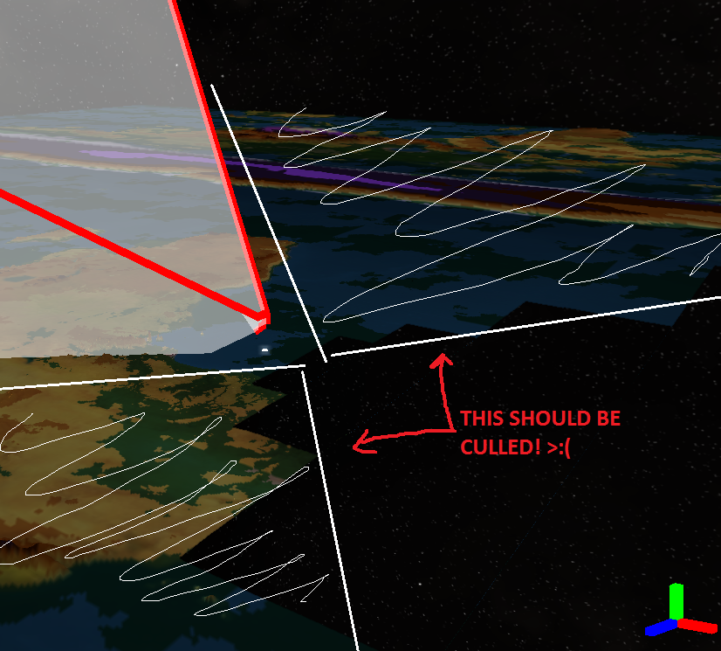
4. Frustrum culling
Problem: flat planes culled. Vertex height after sampling not taken in account.

Slide 9
5. Sample height-map by world positions
Get world’s XY coordinates.
“Snap” coordinates to avoid flickering. We get poping instead…
Sample at Mipmap == LOD level.
Interlevel mesh samples at level + 1 for the outer vértices.

Slide 10
6. Modify vertex altitude
Set v.y to sampled height [0,1].
Scale by arbitrary S.
Avoid scaling on Y when aplying model matrix.

Slide 11
DEMO!

Slide 12
When should this algorithm be used?
When rendering terrain at ground level.
Low detail appear far to camera.
High detail hides lower detail.

Slide 13
Other approaches (view-dependant LOD)
Bin-tree hierarchies.
https://www.youtube.com/watch?v=rL8zDgTlXso&t=428s (3:20)
Tiled blocks: partition the terrain into square patches that are tessellated at different resolutions.

Slide 14
Pros
Constant Time Rendering.
Optimal rendering throughput (not very large meses).
Surface shading.
Synthesis (heightmap + procedural noise).

Slide 15
Cons
Flickering / Popping
XZ based LOD (low-res terrain can be seen from high altitude).
Floating-point precision at hight levels.
Aliasing (sampling many vertices to the same pixel).

Slide 16
Question time

